Slide 1
Data Preprocessing

Slide 2
What is Data Preprocessing?
Data Preprocessing is that step in which the data gets transformed, or Encoded, to bring it to such a state that now the machine can easily parse it.

Slide 3
Why do we need Data Preprocessing?
Data in the real world is dirty.
Data can be noisy, incomplete or inconsistent.
Unscaled data might have unacceptable prediction.

Slide 4
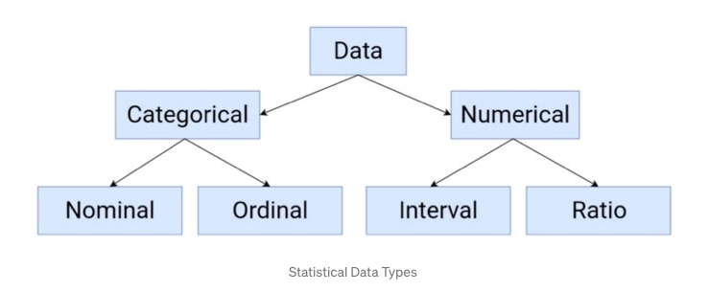
Features in Machine Learning
As per wikipedia, a feature is an individual measurable property or characteristic of a phenomenon being observed.
Types -

Slide 5
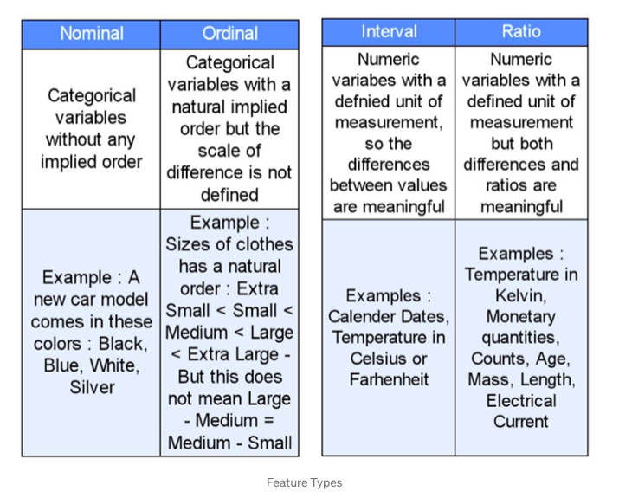

Slide 6
Steps in Data Preprocessing
Data Quality Assessment
Feature Aggregation
Feature Sampling
Dimensionality Reduction
Feature Encoding
Feature Scaling

Slide 7
Data Quality Assessment
Missing Values
Eliminate rows with missing data.
Estimating missing values (Imputation).
Inconsistent Values
Duplicate Values

Slide 8
Feature Aggregation
Feature aggregation puts data in a better perspective by taking aggregated values.
Less memory consumption
Behaviour of groups is more stable.

Slide 9
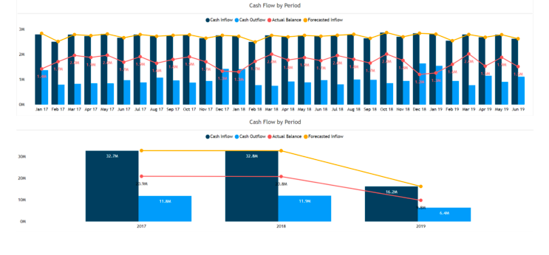

Slide 10
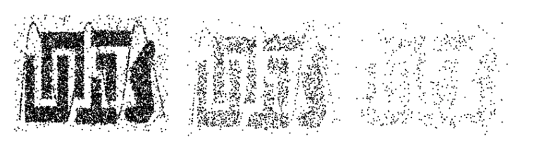
Feature Sampling
Sampling is a data reduction technique.
The key principle is to find a representative sample.
8000 points
2000 points
500 points

Slide 11
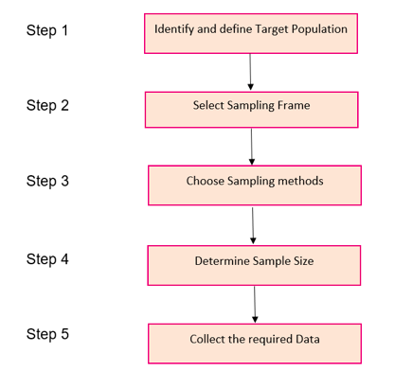
Steps involved in Sampling

Slide 12
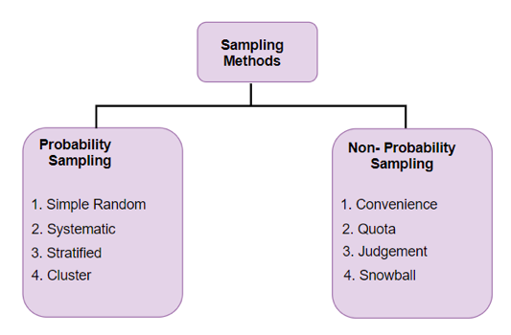
Different Types of Sampling Techniques

Slide 13
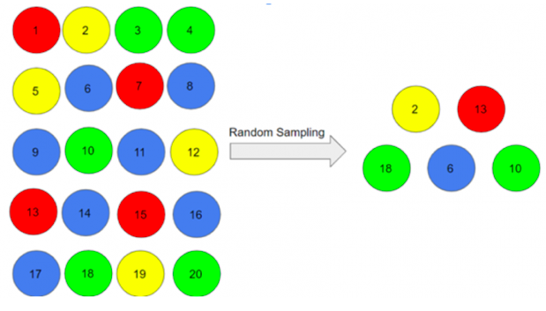
Simple Random Sampling
There is an equal probability of
selecting any particular item.

Slide 14
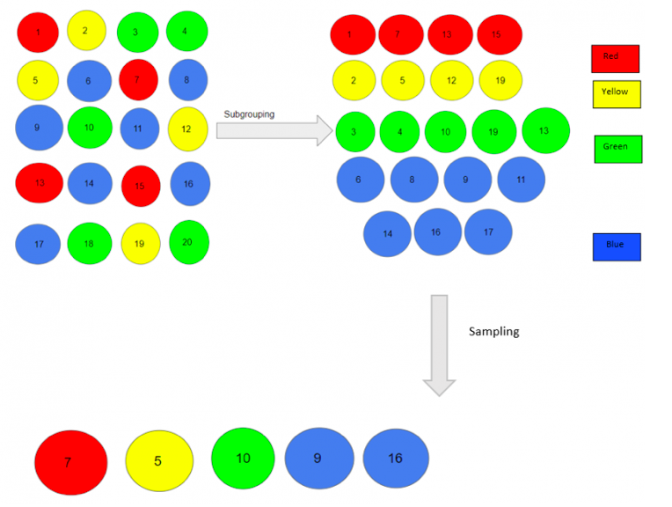
Stratified Sampling
Split the data into several partitions;
then draw random samples from
each partition.
For further study: https://towardsdatascience.com/the-5-sampling-algorithms-every-data-scientist-need-to-know-43c7bc11d17c

Slide 15
Dimensionality Reduction
In dimensionality reduction, data encodings or transformations are applied so as to obtain a reduced or “compressed” representation of the original data.
Two types - Lossy and Lossless.

Slide 16
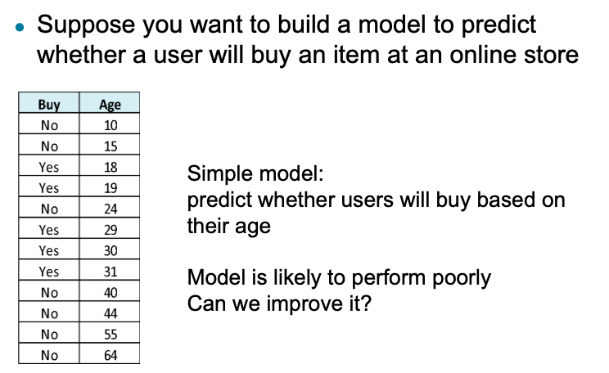
Curse of Dimensionality

Slide 17
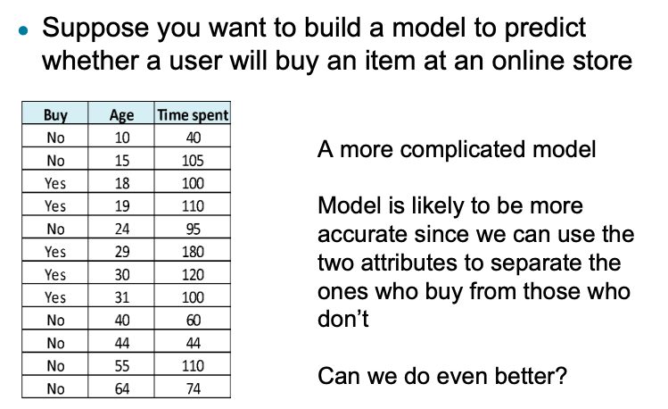

Slide 18
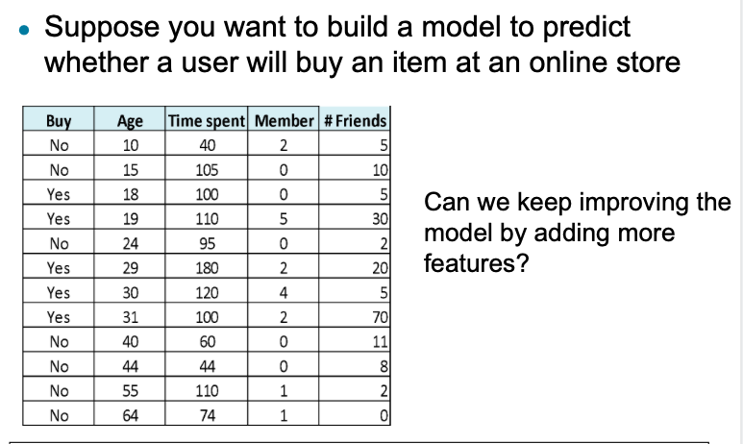

Slide 19
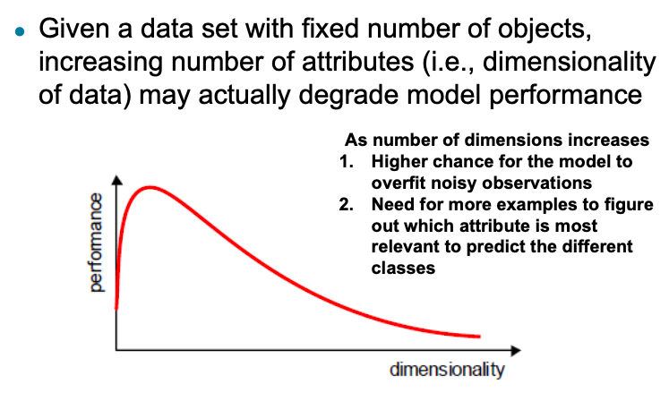

Slide 20
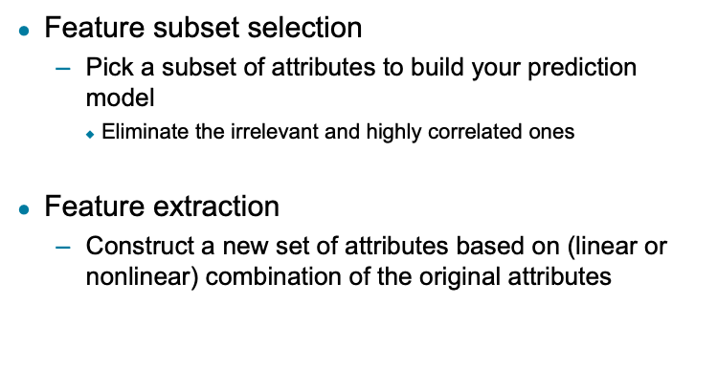
Overcoming Curse of Dimensionality

Slide 21
Other Techniques
PCA - Principal Components Analysis
SVD - Singular Value Decomposition
For detailed explanation:
First watch 3Blue1Brown Eigenvectors video:https://youtu.be/PFDu9oVAE-g?list=PLZHQObOWTQDPD3MizzM2xVFitgF8hE_ab
https://towardsdatascience.com/singular-value-decomposition-and-its-applications-in-principal-component-analysis-5b7a5f08d0bd

Slide 22
Feature Encoding
Feature encoding is basically performing transformations on the data such that it can be easily accepted as input for machine learning algorithms while still retaining its original meaning.

Slide 23
Feature Encoding
It is generally used for encoding categorical data.
Two types -
Label Encoding and
One Hot Encoding.

Slide 24
Label Encoding
Learning algorithms don’t understand strings.
Categorical columns with string values (Yes/No) needs to be converted to numbers.
Label Encoder encodes value between 0 to (n-1) classes.

Slide 25
One Hot Encoding
Converts each categorical data into vector, one value will be hot and others cold.
Suitable for nominal data.
Like locations (Delhi, Mumbai, etc).

Slide 26
Feature Scaling
Scales the features so as to improve accuracy of the model while training.
Mainly two types -
Standardization - StandardScaler class
Normalization- MinMaxScaler class.

Slide 27
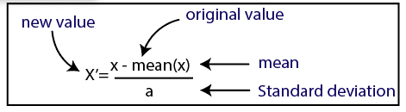
StandardScaler
Assumes features data should be normally distributed.
Scales such that central tendency is 0 and standard deviation 1.
Brings the data in range [-1, 1].

Slide 28
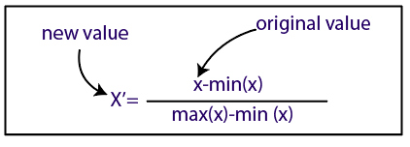
MinMaxScaler
One of the most popular scaling method.
Works on data which is not normally distributed.
Brings the data in range [0, 1].

Slide 29
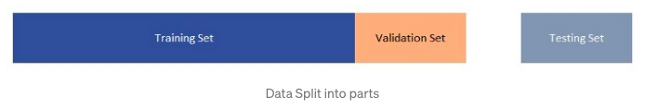
Train/Validation/Test Split
Training Data
Validation Data
Test Data
Split Ratio

Slide 30
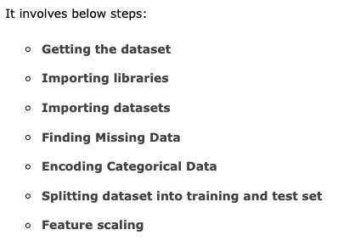
Implementation

Slide 31
Getting the Dataset
To use the dataset, we generally put it into a CSV file.
CSV - Comma Separated Values
For this particular implementation we have used this dataset:
Get Materials

Slide 32


Importing Libraries
Importing Dataset

Slide 33
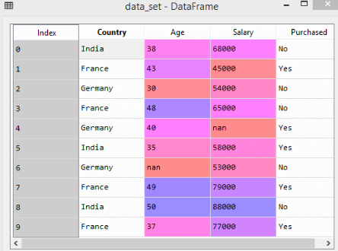

Slide 34

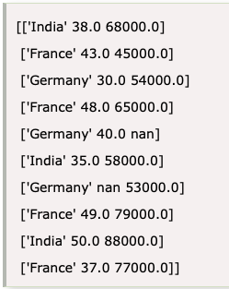
Extracting dependent and independent variables:
Dependent:

Slide 35

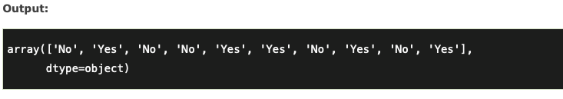
Independent:

Slide 36
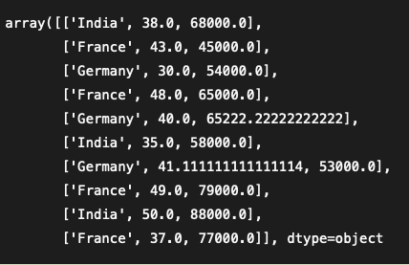
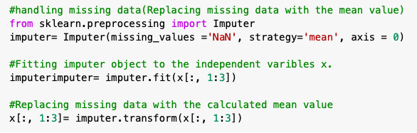
Handling Missing Data

Slide 37
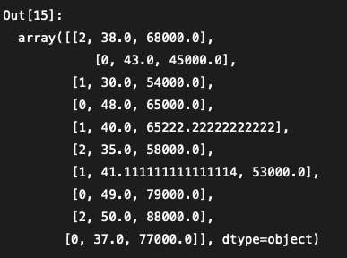

Encoding Categorical Data- Label Encoding

Slide 38
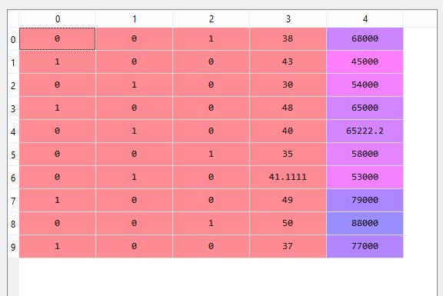
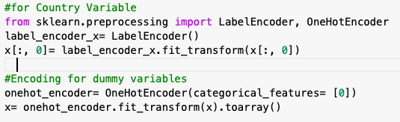
One Hot Encoding

Slide 39
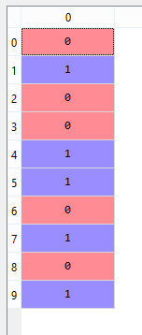
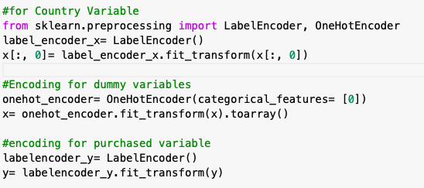

Slide 40

Splitting the Dataset into the Training set and Test set

Slide 41
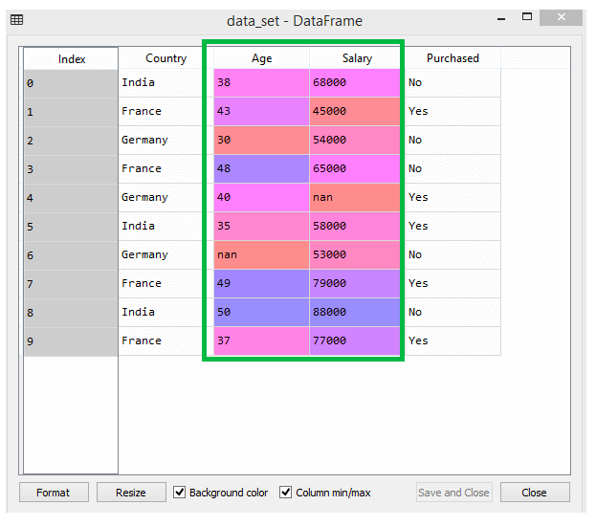
Feature Scaling

Slide 42
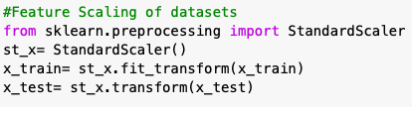
Standardization

Slide 43
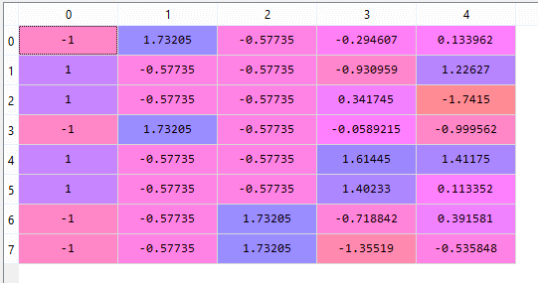
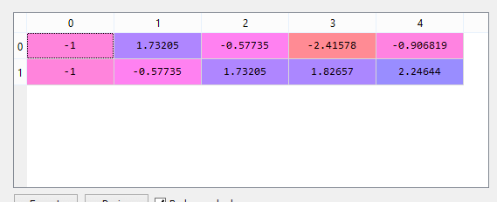
x_train
x_test

Slide 44
Assignment
Use this dataset: Download Data
Check for missing values, etc (if any).
Try out KNN and Linear Regression models on this dataset before scaling and find out the corresponding accuracies.
Now apply feature scaling- (standardization and normalization) on the dataset and find out which model (KNN and Linear Regression) gives better accuracy for which type of scaling. E.g. KNN may give better accuracy on normalization than standardization. Also find the difference in accuracies for each type of scaling from the initial accuracy when no scaling was applied.
Find why one kind of scaling is giving better accuracy than other on a particular model.

